Slide 1
Computer Architecture & Assembly Language
CSC-250
COURSE LECTURE
COMPUTER SCIENCE DEPARTMENT
SIBAU KANDHKOT CAMPUS

Slide 2
History of computer
MECHANICAL
ELOCTRO MECHANICAL
ELECTRONIC
MODREN

Slide 3
ENIAC
Electronic Numerical Integrator And Computer
Decimal (not binary)
20 accumulators of 10 digits (ACCUMULATOR:
Programmed manually by switches
18,000 vacuum tubes
30 tons
15,000 square feet
140 kW power consumption
5,000 additions per second
An accumulator is a register for short-term, intermediate storage of arithmetic and logic data in a computer's CPU The term "accumulator" is rarely used in reference to contemporary CPUs, having been replaced around the turn of the millennium by the term "register." In a modern computers, any register can function as an accumulator
Eckert and Mauchly
University of Pennsylvania
Trajectory tables for weapons
Started 1943
Finished 1946
  Too late for war effort
Used until 1955

Slide 4
von Neumann/Turing
Stored Program concept
Main memory storing programs and data
ALU operating on binary data
Control unit interpreting instructions from memory and executing
Input and output equipment operated by control unit
Princeton Institute for Advanced Studies (IAS) computer
Completed 1952

Slide 5
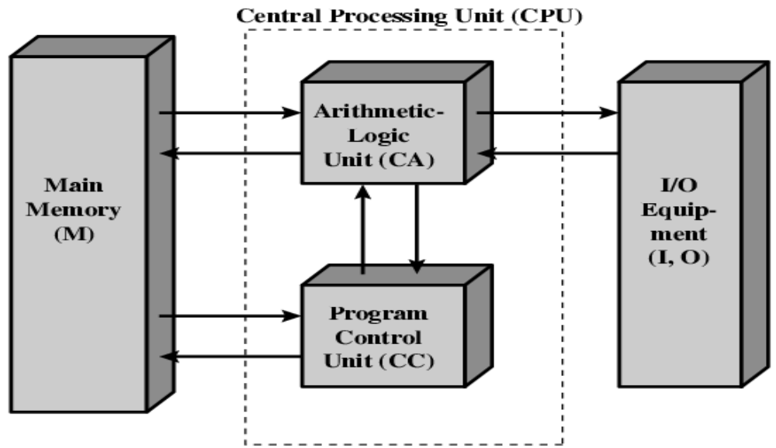
Structure of von Neumann machine

Slide 6
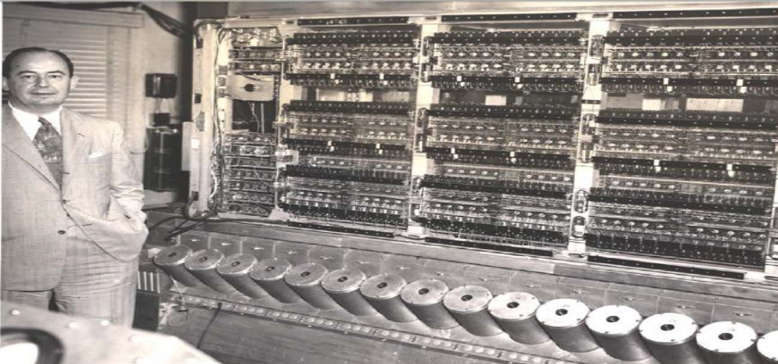
John von Neumann and the IAS machine, 1952

Slide 7
Commercial Computers
1947 -Eckert-Mauchly Computer Corporation
UNIVAC I(Universal Automatic Computer)
US Bureau of Census 1950 calculations
Became part of Sperry-Rand Corporation
Late 1950s -UNIVAC II
—Faster
—More memory

Slide 8
IBM (International Business Machines Corporation)
Punched-card processing equipment
1953 -the 701
IBM’s first stored program computer
Scientific calculations
1955 -the 702
Business applications
Lead to 700/7000 series

Slide 9
Transistors
Replaced vacuum tubes
Smaller
Cheaper
Less heat dissipation
Solid State device
Made from Silicon (Sand)
Invented 1947 at Bell Labs
William Shockley et al.

Slide 10
Transistor Based Computers
Second generation machines
NCR & RCA produced small transistor machines
IBM 7000
DEC - 1957
  Produced PDP-1

Slide 11
Microelectronics
Literally - “small electronics”
A computer is made up of gates, memory cells and interconnections
These can be manufactured on a semiconductor
e.g. silicon wafer

Slide 12
Generations of Computers
Vacuum tube -1946-1957
Transistor -1958-1964
Small scale integration -1965 on
Up to 100 devices on a chip
Medium scale integration -to 1971
100-3,000 devices on a chip
Large scale integration -1971-1977
3,000 -100,000 devices on a chip
Very large scale integration -1978 -1991
100,000 -100,000,000 devices on a chip
Ultra large scale integration –1991 -
Over 100,000,000 devices on a chip

Slide 13
Moore’s Law
Increased density of components on chip
Gordon Moore –co-founder of Intel
Number of transistors on a chip will double every year
Since 1970’s development has slowed a little
Number of transistors doubles every 18 months
Cost of a chip has remained almost unchanged
Higher packing density means shorter electrical paths, giving higher performance
Smaller size gives increased flexibility
Reduced power and cooling requirements
Fewer interconnections increases reliability

Slide 14
Rock’s Law
Arthur Rock, is a corollary to Moore’s law: “The cost of capital equipment to build semiconductor will double every four years”
Rock’s Law arises from the observations of a financier who has seen the price tag of new chip facilities escalate from about $12,000 in 1968 to $12 million in the late 1990s.
At this rate, by the year 2035, not only will the size of a memory element be smaller than an atom, but it would also require the entire wealth of the world to build a single chip!
So even if we continue to make chips smaller and faster, the ultimate question may be whether we can afford to build them

Slide 15
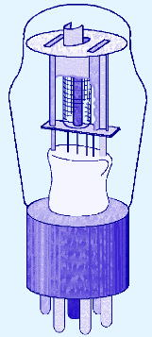
1st Generation Computers
  Used vacuum tubes for logic and storage (very little storage available)
  A vacuum-tube circuit storing 1 byte
  Programmed in machine language
  Often programmed by physical connection (hardwiring)
  Slow, unreliable, expensive
  The ENIAC – often thought of as the first programmable electronic computer – 1946
  17468 vacuum tubes, 1800 square feet, 30 tons

Slide 16
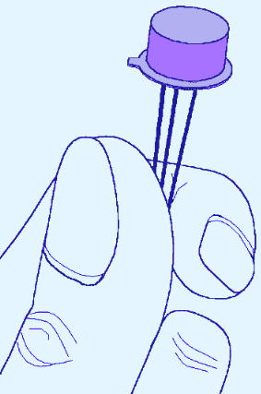
2nd Generation Computers
Transistors replaced vacuum tubes
Magnetic core memory introduced
  Changes in technology brought about cheaper and more reliable computers (vacuum tubes were very unreliable)
  Because these units were smaller, they were closer together providing a speedup over vacuum tubes
  Various programming languages introduced (assembly, high-level)
  Rudimentary OS developed
    The first supercomputer was introduced, CDC 6600 ($10 million)

Slide 17
Second generation of computers Transistors
Replaced vacuum tubes
Smaller
Cheaper
Less heat dissipation
Solid State device
Made from Silicon (Sand)
Invented 1947 at Bell Labs by William Shockley et al.

Slide 18
3rd Generation Computers
ability to place circuits onto silicon chips
  Replaced both transistors and magnetic core memory
  Result was easily mass-produced components reducing the cost of computer manufacturing significantly
  Also increased speed and memory capacity
  Computer families introduced
  Minicomputers introduced
  More sophisticated programming languages and OS developed
    Popular computers included PDP-8, PDP-11, IBM 360 and Cray produced their first supercomputer, Cray-1
  Silicon chips now contained both logic (CPU) and memory
  Large-scale computer usage led to time-sharing OS

Slide 19
Third generation of computers Integrated Circuits
A computer is made up of gates, memory cells and interconnections
All these can be manufactured either separately (discrete components) or
on the same piece of semiconductor (a.k.a. silicon wafer)

Slide 20
4th Generation Computers
1971-Present: Microprocessors
Miniaturization took over
  From (10-100 components per chip) to (10,000+)
Thousands of ICs were built onto a single silicon chip(VLSI), which allowed Intel, in 1971, to
  create the world’s first microprocessor, the 4004, which was a fully functional, 4-bit system that ran at 108KHz.
  Intel also introduced the RAM chip, accommodating 4Kb of memory on a single chip. This allowed computers of the 4th generation to become smaller and faster than their solid-state predecessors
  Computers also saw the development of GUIs, the mouse and handheld devices

Slide 21
Microprocessors -Intel
1971 -4004
First microprocessor
All CPU components on a single chip
4 bit
Multiplication by repeated addition, no hardware multiplier!
Followed in 1972 by 8008
8 bit
Both designed for specific applications
1974 -8080
Intel’s first general purpose microprocessor

Slide 22
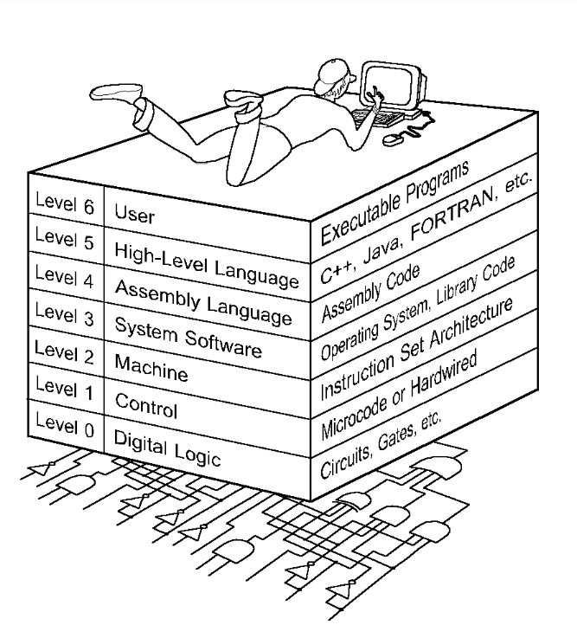
Computer Level Hierarchy

Slide 23
The Von Neumann Architecture
Named after John von Neumann, Princeton, he designed a computer architecture whereby data and instructions would be retrieved from memory,
operated on by an ALU, and moved back to memory (or I/O)
This architecture is the basis for most modern computers (only parallel processors and a few other unique architectures use a different model)

Slide 24
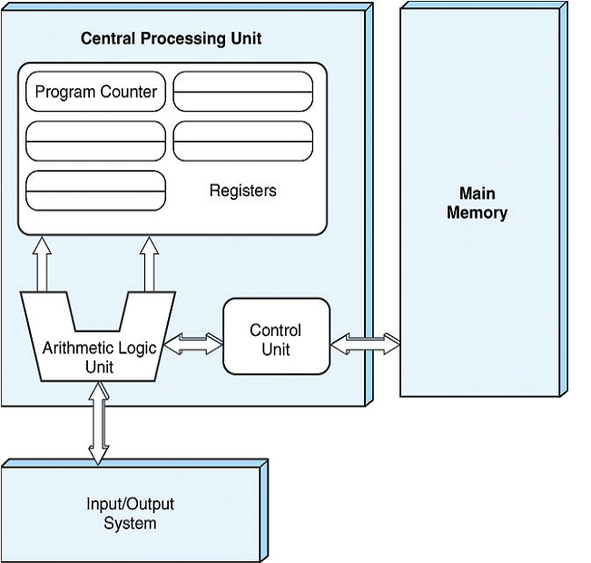
Hardware consists of 3 units
  CPU (control unit, ALU, registers)
  Memory (stores programs and data)
  I/O System (including secondary storage)
Instructions in memory are executed sequentially unless a program instruction explicitly changes the order

Slide 25
Von Neumann Architectures
There is a single pathway used to move both data and instructions between memory, I/O and CPU
  the pathway is implemented as a bus
  the single pathway creates a bottleneck
    known as the von Neumann bottleneck
  A variation of this architecture is the Harvard architecture which separates data and instructions into two pathways
  Another variation, used in most computers, is the system bus version in which there are different buses between CPU and memory and memory and I/O

Slide 26
Fetch-execute cycle
The von Neumann architecture operates on the fetch-execute cycle
  Fetch an instruction from memory as indicated by the Program Counter register
  Decode the instruction in the control unit
  Data operands needed for the instruction are fetched from memory
  Execute the instruction in the ALU storing the result in a register
  Move the result back to memory if needed

Slide 27
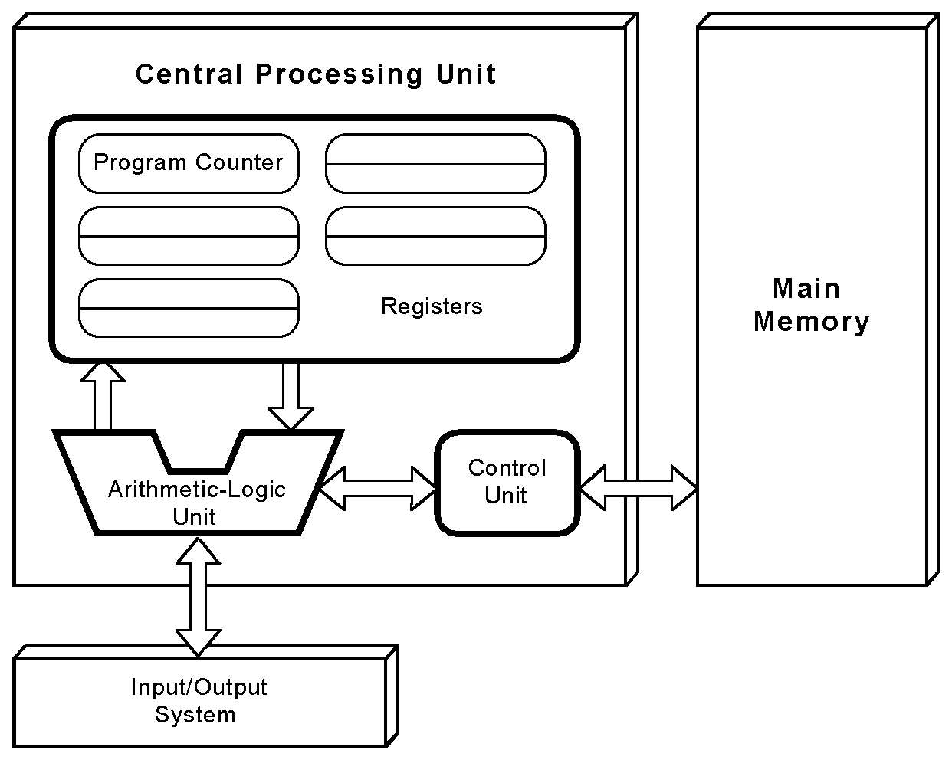
The von Neumann Model
This is a general depiction of a von Neumann system:
These computers employ a fetch-decode-execute cycle to run programs as follows . . .

Slide 28
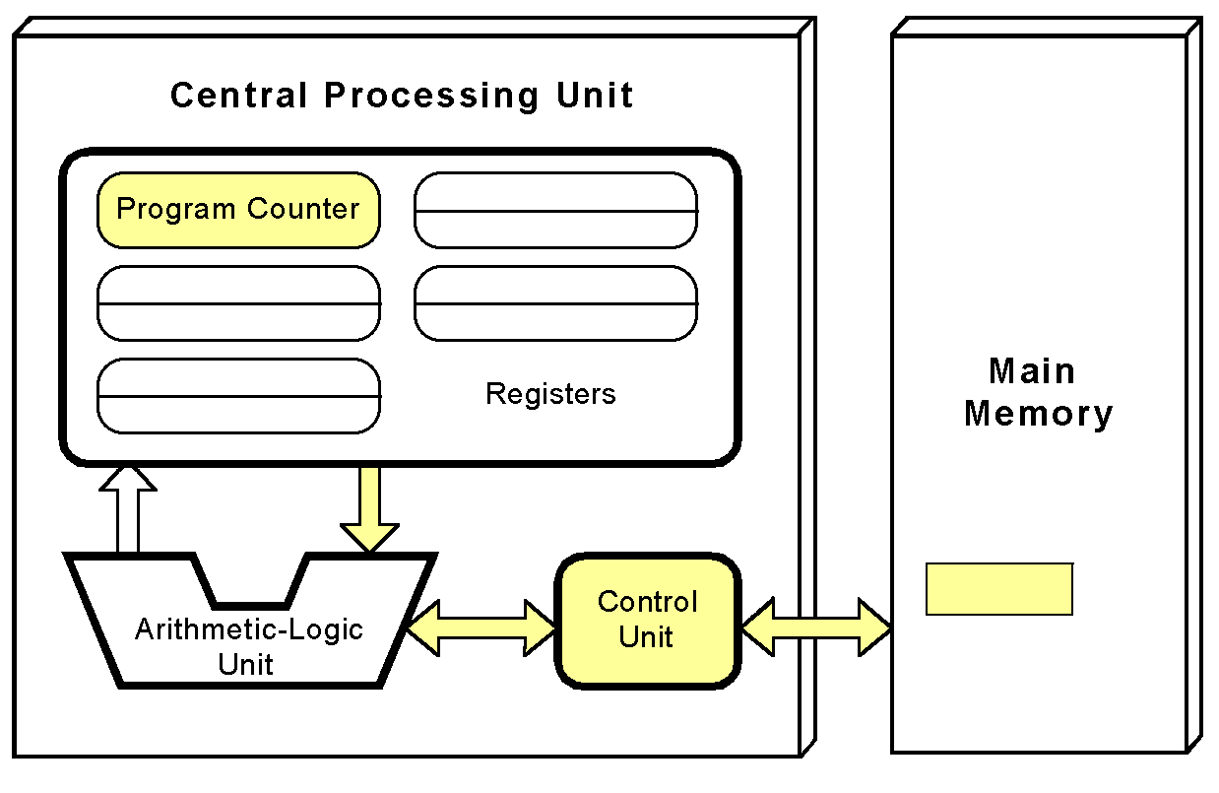
The von Neumann Model
The control unit fetches the next instruction from memory using the program counter to determine where the instruction is located

Slide 29
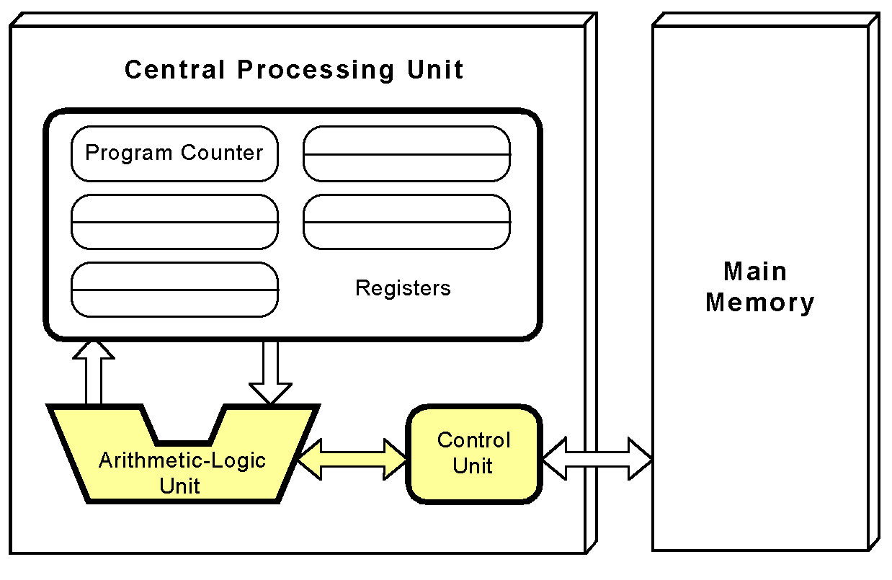
The von Neumann Model
The instruction is decoded into a language that the ALU can understand.

Slide 30
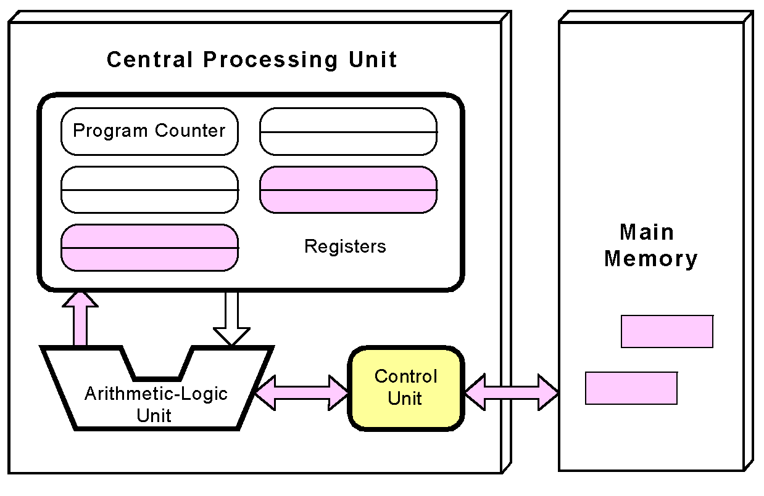
The von Neumann Model
Any data operands required to execute the instruction are fetched from memory and placed into registers within the CPU.

Slide 31
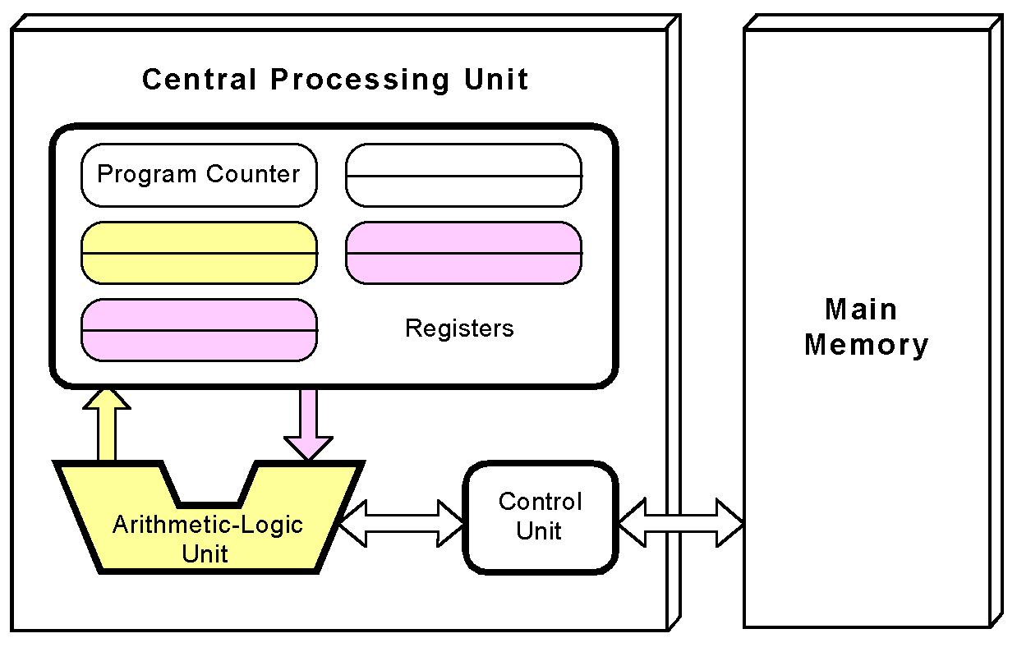
The von Neumann Model
The ALU executes the instruction and places results in registers or memory.

Slide 32
Non-von Neumann Models
Conventional stored-program computers have undergone many incremental improvements over the years
  specialized buses
  floating-point units
  cache memories
But enormous improvements in computational power require departure from the classic von Neumann architecture
  Adding processors is one approach

Slide 33
Non-von Neumann Models
In the late 1960s, high-performance computer systems were equipped with dual processors to increase computational throughput.
In the 1970s supercomputer systems were introduced with 32 processors.
Supercomputers with 1,000 processors were built in the 1980s.
In 1999, IBM announced its Blue Gene system containing over 1 million processors.

Slide 34
Parallel Computing
Parallel processing allows a computer to simultaneously work on subparts of a problem.
Multicore processors have 2 or more processor cores sharing a single die.
Each core has its own ALU and set of registers, but all processors share memory and other resources.
“Dual core” differs from “dual processor.”
  Dual-processor machines, have two processors, but each processor plugs into the motherboard separately.
Multi-core systems provide the ability to multitask
  E.g., browse the Web while burning a CD
Multithreaded applications spread mini-processes, threads, across one or more processors for increased throughput.

Slide 35
Computing as a Service Cloud Computing
The ultimate aim of every computer system is to deliver functionality to its users.
Computer users typically do not care about terabytes of storage and gigahertz of processor speed.
Many companies outsource their data centers to 3rd-party specialists, who agree to provide computing services for a fee.
These arrangements are managed through service-level agreements (SLAs).
Rather than pay a third party to run a company-owned data center, another approach is to buy computing services from someone else’s data center and connect to it via the Internet.
This is the idea behind a collection of service models known as Cloud computing.

Slide 36
Cloud Computing
Enabling on-demand network access to a shared pool of configurable computing resources (e.g., networks, servers, applications, and services) that can be rapidly provisioned and released with minimal management effort or service provider interaction

Slide 37
Cloud Computing
Cloud computing models:
  Software as a Service,
    The consumer of this service buy application services
  Platform as a Service,
    Provides server hardware, operating systems, database services, security components, and backup and recovery services
  Infrastructure as a Service
    provides only server hardware, secure network access to the servers, and backup and recovery services. The customer is responsible for all system software including the operating system and databases

Slide 38
Grid computing
Combination of computer resources from multiple administrative domains to reach a common goal.
What distinguishes grid computing from conventional high performance computing systems s.a cluster computing is that grids tend to be more loosely coupled, heterogeneous, and geographically dispersed.
Although a grid can be dedicated to a specialized application, it is more common that a single grid will be used for a variety of different purposes

Slide 39
Cluster computing
A group of linked computers, working together closely thus in many respects forming a single computer. The components of a cluster are commonly, but not always, connected to each other through fast LANs
Clusters are usually deployed to improve performance and availability over that of a single computer, while typically being much more cost-effective than single computers of comparable speed or availability

Slide 40
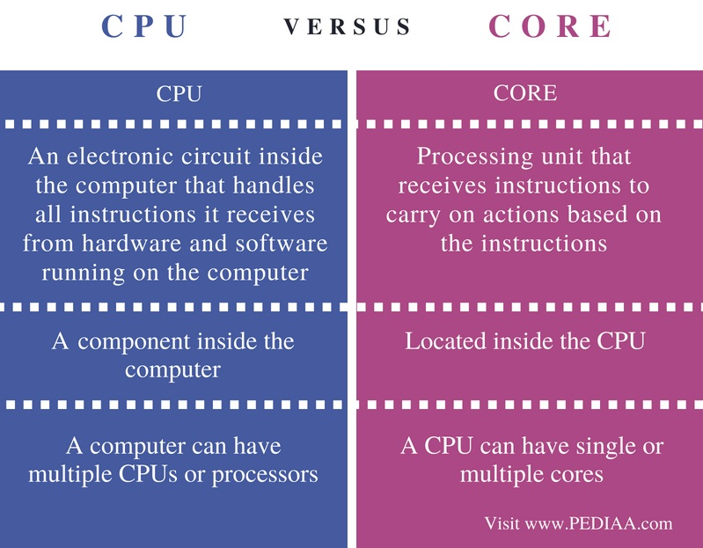
CORE VS PROCESSOR

Slide 41
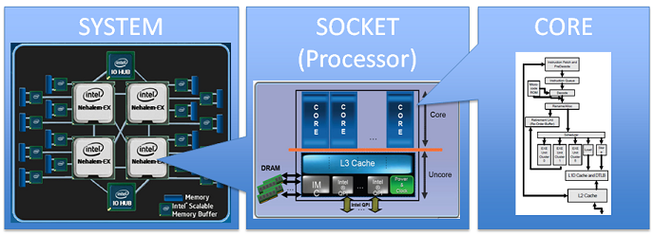

Slide 42
ASSIGNMENT
MEASURE THE PERFORMANCE OF SYSTEM INSTRUCTION

Slide 43
Computer Performance Measures
Program Execution Time
For a specific program compiled to run on a specific machine “A”, the following parameters are provided:
  The total instruction count of the program.
  The average number of cycles per instruction (average CPI).
  Clock cycle of machine “A”
How can one measure the performance of this machine running this program?
  The machine is said to be faster or has better performance running this program if the total execution time is shorter.
  Thus the inverse of the total measured program execution time is a possible performance measure or metric:
  Performance_{A} = 1 / Execution Time_{A}
  How to compare performance of different machines?
  What factors affect performance? How to improve performance?

Slide 44
Comparing Computer Performance Using Execution Time
To compare the performance of two machines “A”, “B” running a given specific program
Performance_{A} = 1 / Execution Time_{A}
Performance_{B} = 1 / Execution Time_{B}
Machine A is n times faster than machine B means:
Example:
For a given program:
  Execution time on machine A: Execution_{A} = 1 second
  Execution time on machine B: Execution_{B} = 10 seconds
  Performance_{A} / Performance_{B} = Execution Time_{B} / Execution Time_{A}
  = 10 / 1 = 10
  The performance of machine A is 10 times the performance of machine B when
  running this program, or: Machine A is said to be 10 times faster than machine B
  when running this program.
Performance_{A}
Execution Time_{B}
Speedup = n = =
Performance_{B}
Execution Time_{A}

Slide 45
CPU Execution Time The CPU Equation
A program is comprised of a number of instructions executed , I
  Measured in: instructions/program
The average instruction takes a number of cycles per instruction (CPI) to be completed.
  Measured in: cycles/instruction, CPI
CPU has a fixed clock cycle time C = 1/clock rate
  Measured in: seconds/cycle
CPU execution time is the product of the above three parameters as follows:
CPU time = Seconds = Instructions x Cycles x Seconds
Program Program Instruction Cycle
T = I x CPI x C

Slide 46
Example
A Program is running on a specific machine with the following parameters:
  Total executed instruction count: 10,000,000 instructions
  Average CPI for the program: 2.5 cycles/instruction.
  CPU clock rate: 200 MHz.
What is the execution time for this program?
CPU time = Instruction count x CPI x Clock cycle
= 10,000,000 x 2.5 x 1 / clock rate
= 10,000,000 x 2.5 x 5x10⁻⁹
= .125 seconds

Slide 47
Example
From the previous example: A Program is running on a specific machine with the following parameters:
  Total executed instruction count, I: 10,000,000 instructions
  Average CPI for the program: 2.5 cycles/instruction.
  CPU clock rate: 200 MHz.
Using the same program with these changes:
  A new compiler used: New instruction count 9,500,000
  New CPI: 3.0
  Faster CPU implementation: New clock rate = 300 MHZ
What is the speedup with the changes?
Speedup = (10,000,000 x 2.5 x 5x10⁻⁹) / (9,500,000 x 3 x 3.33x10⁻⁹ )
= .125 / .095 = 1.32
or 32 % faster after changes.
Speedup = Old Execution Time = I_{old} x CPI_{old} x Clock cycle_{old}
New Execution Time I_{new} x CPI_{new} x Clock Cycle_{new}

Slide 48
